Slide 1
Case Study: Classification
Machine Learning

Slide 2
Course Outline
Assignments are submitted at the same date as the next assignment comes out
Wk | Lecture 1 | Lecture 2 | Individual Assignment | Project Assignment
1 | Case Study: Regression | Case Study: Classification | A1: Car Price Prediction
2 | Batch Gradient Descent | Stochastic / Mini-Batch Gradient Descent
3 | Regularization | Binary Logistic Regression | A2: TBD
4 | Multinomial Logistic Regression | Gaussian Naive Bayes
5 | Multinomial Naive Bayes | K-Nearest Neighbors | A3: TBD
6 | Support Vector Machine | Support Vector Machine II
7 | No class | Midterm Exam |  | Phase 1: Reading paper round 1 (KDD)
8 | Decision Tree | Bagging / Random Forests |  | Phase 1: Reading paper round 2 (KDD)
9 | Ada Boosting / Gradient Boosting | K-Means Clustering |  | Phase 2: Proposal - Paper writing (Intro, Related Work, Method)
10 | Gaussian Mixture | Principal Component Analysis
11 | PyTorch Linear Regression | Project Proposal Presentation |  | Phase 3: Experiment - Paper writing (Intro, Related Work, Method, Results)
12 | PyTorch Logistic Regression | Convolutional Neural Network
13 | Recurrent Neural Network | Reinforcement Learning
14 | Q-learning | Project Progress Presentation |  | Phase 4: Conclusion - Paper writing (Abstract, Intro, Related Work, Method, Results, Discussion, Conclusion)
15 | No class | Final Exam
16 | No class | Final Project Presentation

Slide 3
Background - Classification
Predict cancer or no cancer using sizes?
Predict positive or negative given a sentence?
Predict car brands using images?
Notice all the labels here are categorical (discrete) values?
Classification is a supervised algorithm to predict categorical (discrete) values
Labels must be categorical; features can be categorical or continuous
Labels can be binary (two class) or multiclass
Supervised - has both features and labels; Unsupervised - only has features

Slide 4
Big picture of ML
1. Load data -> 2. Exploratory Data Analysis -> 3. Feature engineering -> 4. Feature selection -> 5. Preprocessing
CSV, JSON, Database
Renaming
Label encoding
Countplot
Distribution plot
Boxplot
Scatter plot
Correlation Matrix
Predictive Power Score
Dimensionality reduction
Feature splitting (e.g., date)
Creating features (e.g., some equation)
Train / dev / test set
Select your X (features) and y (target)
In ML, it’s better to choose X
In DL, we usually just input all features
Null values
Outliers
Typos / Entry errors / Duplicates / IDs
Scaling (min-max; standardize)
6. Model selection -> 7. Testing -> 8. Analysis -> 9. Inference -> 10. Deployment
Supervised
Regression
Classification
Unsupervised
Clustering
Dimensionality reduction
Reinforcement
PPO
Q-learning
Apply your best model on your test set
Analyze your model, e.g., feature importance
Apply your best model on some unseen data, and see whether it makes sense
Flask
Django
FastAPI
TOOLS
Python, R - programming tool
NumPy (matrix manipulation), Pandas (Excel-like), Matplotlib/Seaborn (visualization), Sklearn (machine learning), PyTorch (deep learning)
Tableau, Power BI - Business Intelligence (BI) tools
Microsoft Azure, Rapidminer, Weka - data science and machine learning tools
SPSS, SAS, JASP - statistical tool
Docker
METRIC
Regression (r², MSE)
Classification (recall, precision, f1)
Clustering (inertia)
Dimensionality reduction (mean squared distance between the original data and the reconstructed data)
Reinforcement learning (cumulative rewards)
MLFlow
Wandb
Tensorboard
TOP VENUES
ML (KDD)
DL (ICML, NIPS, ICMR)
NLP (ACL, EMNLP)
CV (CVPR, ICCV)
Cross-validation
Grid search

Slide 5
One-hot encoding
Recall label encoding which we turn categories into 0, 1, 2 etc.
When we have more than two categories, if we encode into 0, 1, 2
we create a unintentional order, i.e., the model "may" think that 0 < 1 < 2
Possible solution: one hot encoding
E.g., Male, Female, Unknown ⇒ [1, 0, 0] if male; [0, 1, 0] if female
Limitation
what if we have like 5000 categories....
one hot encode this will result in 5000 columns --> too much! -> Two choices:
Group these categories into bigger categories, and then one-hot encode
Do label encoding anyway......but note the possible order effect
Tips: one thing you need to know is that you can always cut down one column
[1, 0, 0], [0, 1, 0], [0, 0, 1] is same as [1, 0], [0, 1], [0, 0] by setting ‘drop_first=True’

Slide 6
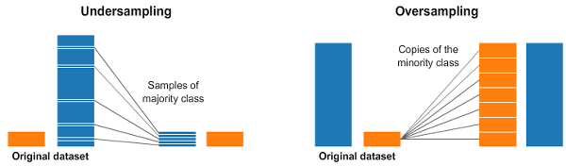
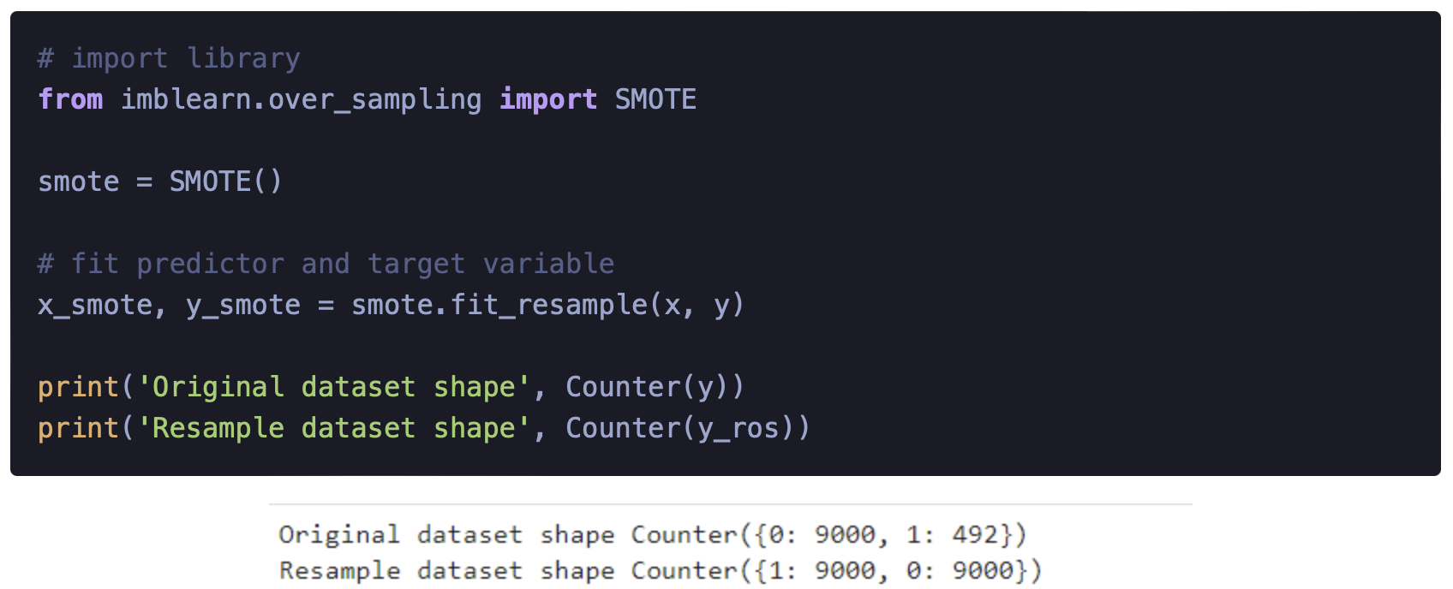
Class imbalance
In classification, it’s important to check the class imbalance
For example, if you want to predict cat or dog, but you have 100 images of cat, but 1000 images of dogs
Ways to deal with class imbalance
Sample randomly 100 images of dogs (downsampling) - loss of information
Randomly augment 900 more images of cat (upsampling) - redundant info
If class imbalance exists, you MUST not use “accuracy”, use recall / precision / f1-score instead

Slide 7
Classification metrics
Given:
y = [0, 0, 0, 1, 1, 1, 1, 1, 1, 1, 1]
ypred = [1, 0, 1, 1, 1, 0, 1, 1, 1, 1, 1]
accuracy = (TP + TN) / (TP + FP + FN + TN)
accuracy = (7 + 1) / (7 + 2 + 1 + 1) = 8 / 11 = 72%
Bad for imbalance y
recall = TP / (TP + FN)
recall = (7) / (7 + 1) = 7 / 8 = 87.5%
Good for minimizing FN, e.g., cancer
Confusion Matrix
Actual
P N
P 7 2
Predict
N 1 1
precision = TP / (TP + FP)
precision = (7) / (7 + 2) = 7 / 9 = 77%
Good for minimizing FP, e.g., search engine
f1 = 2 * ( (recall * precision) / (precision + recall) )
f1 = 2 * ( (87.5 * 77) / (87.5 + 77) ) = 81.9%
Balance
We called 3 as True Positive, 2 as False Positive, 1 as False Negative, and the bottom right one as True Negative

